Slide 1
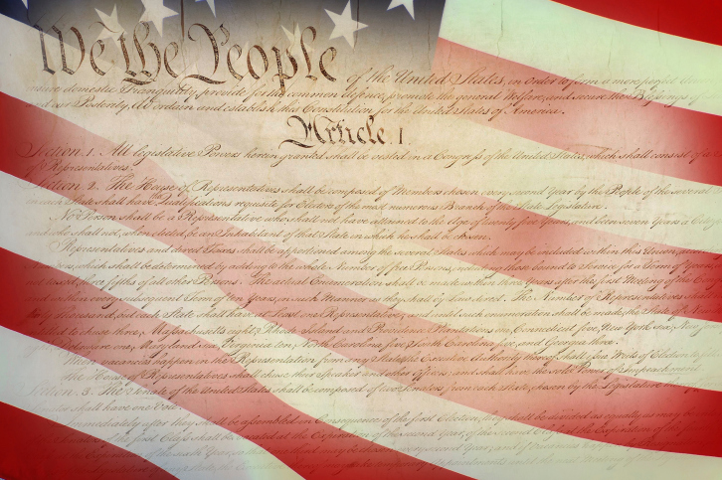
Affirmative Action: Its historical and legal bass and the Fourteenth Amendment’s Equal Protection Clause

Slide 2
14th Amendment
Section 1: All persons born or naturalized in the United States, and subject to the jurisdiction thereof, are citizens of the United States and of the State wherein they reside. No State shall make or enforce any law which shall abridge the privileges or immunities of citizens of the United States; nor shall any State deprive any person of life, liberty, or property, without due process of law; nor deny to any person within its jurisdiction the equal protection of the law.
U.S. Const., amend. XIV

Slide 3
14th Amendment: Equal Protection Clause
Section 1: All persons born or naturalized in the United States, and subject to the jurisdiction thereof, are citizens of the United States and of the State wherein they reside. No State shall make or enforce any law which shall abridge the privileges or immunities of citizens of the United States; nor shall any State deprive any person of life, liberty, or property, without due process of law; nor deny to any person within its jurisdiction the equal protection of the law.
U.S. Const., amend. XIV

Slide 4
Equal Protection Clause History
This clause, like all parts of the Thirteenth, Fourteenth, and Fifteenth Amendments, was enacted shortly after the Civil War, and its primary goal was to secure free and equal treatment for ex-slaves.
Emanuel, 2012
Based on its framing and ratification history, the two key aspects of the Fourteenth Amendment equal protection clause was the public demand from the North that the postwar South be restrained from future discriminating against blacks and Northerners, and that this restraint be imposed without altering radically the structure of the federal system, or increasing markedly the powers of the federal system of government
Nelson, 1988.

Slide 5
Civil Rights
Civil Rights is defined as the rights of people to be treated without unreasonable or unconstitutional differences.
The pertinent question regarding civil rights is not whether the authority to treat people differently; it is whether such differences in treatment are reasonable.
Wilson, Diluilio, & Bose, 2013

Slide 6
Reasonable Distinctions
Classifying people into brackets on the basis of income and taxing them at different rates
Giving adults more rights, such as voting and drinking alcohol, than the rights possessed by minors
All-male draft for the armed services
Wilson, Diluilio, & Bose, 2013

Slide 7
Tests used when determining Constitutionality of distinctions
Three levels of review when evaluating cases dealing with the Equal Protection Clause of the Fourteenth Amendment;
strict scrutiny, the Court evaluates the state statute to ensure it is necessary to promote a compelling governmental interest
mid-level review, the Court ensures the means chosen by the state legislatures must be substantially related to an important governmental objective
rationality review, the Court ensures the statute bears a rational relationship to legitimate governmental objective

Slide 8
Affirmative Action: Reasonable Distinction?
Affirmative action policies in college and university admission programs are designed to increase minority participation. This means providing preferential treatment by giving an edge to qualified minority applicants or setting a numerical goal for the number of minorities admitted
Wilson, Diluilio, & Bose, 2013

Slide 9
Meaning of Equality: A History
Natural Law
The social compact theory argues that in the state of nature, people were born free, equal and independent
Remy, 2003
When food became less plentiful, life became poor or difficult; people’s desire for self preservation would lead them to come together and form governments
Wilson, Diluilio, & Bose, 2013
In agreeing to join the civil society, each individual freely accepts the obligation to protect the rights of fellow citizens in return for the protection of his own rights. The powers of government, therefore, are directed to the equal protection of the equal rights of those who consent to be government.
Wilson, Diluilio, & Bose, 2013

Slide 10
Meaning of Equality: Declaration of Independence
At the root of this debate is the meaning of the term equality.
The principle of equality was enshrined in the U.S. Declaration of Independence, Paragraph 2 (1776) which states, “all men are created equal.”
This clause as well as much within the Declaration of Independence is based upon the social compact theory.
Equal rights-life, liberty, and the pursuit of happiness- require equal protection and is the very definition of the rule of law.
Equal protection of the law is both part of the social compact, the foundation of our government through the Declaration of Independence, and enshrined in the U.S. Constitution
Erler, 2012

Slide 11
Equal Protection Clause Interpretation
Equality of results proponents believe the burden of racism can only be overcome by designing remedies that take race into account
Wilson, Diluilio, & Bose, 2013
Lyndon Johnson described this understanding in a speech he gave at Howard University in 1965, when he said; “freedom is not enough… the next and more profound stage for civil rights… not equality as a right and as a theory but equality as a result”
Erler, p. 2, 2012

Slide 12
Equal Protection Clause Interpretation
Equality of opportunity: everyone should have an equal chance to participate and succeed
Wilson, Diluilio, & Bose, 2013
If it is wrong to discriminate against minorities, it is equally wrong to give them preferential treatment over other groups
Wilson, Diluilio, & Bose, 2013

Slide 13
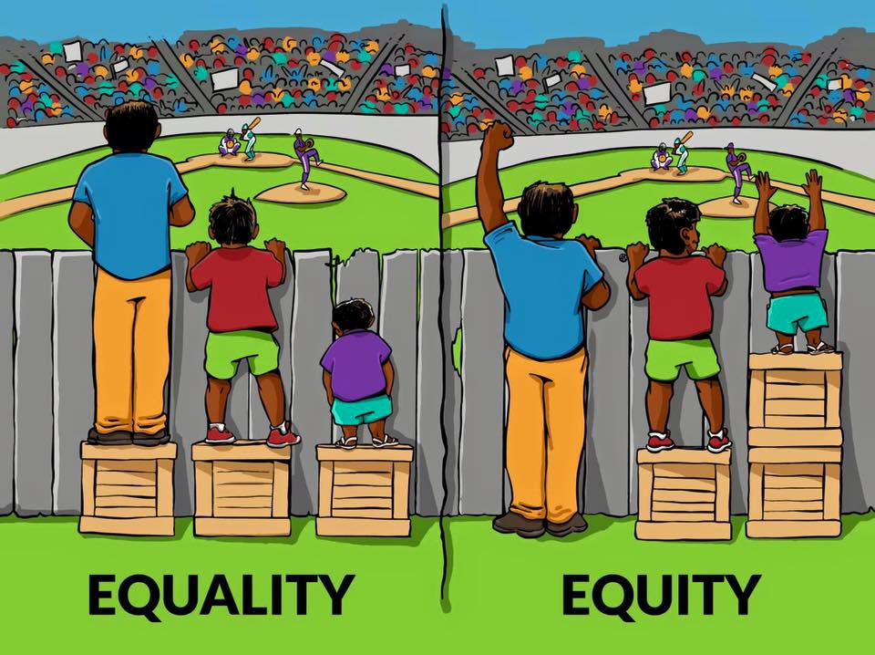
What does “opportunity” and “Fair” mean

Slide 14
Privilege Cartoon
http://www.mbctimes.com/english/this-comic-will-forever-change-the-way-you-look-at-privilege

Slide 15
The American Dream
The American Dream is the Promise that ALL residents of the United States have a reasonable chance to achieve success as they define it (material or otherwise) through their own efforts and resources, and to attain virtue and fulfillment through success.
For many, this means the American Dream is the opportunity to have it better than their parents (material or otherwise).

Slide 16
Equal Protection Clause: Set Up Questions
Assume that African Americans, Hispanics, and Native Americans make up 30% of the high school students in a state but only 12% of the undergraduates enrolled in that state’s public universities. Is that state violating the equal protection rights of those minorities? Does the Fourteenth Amendment’s Equal Protection Clause require equal opportunity or equal results?
The majority opinion in the Grutter law school case includes the following sentence: “We expect that 25 years from now, the use of racial preferences will no longer be necessary to further the interest approved today.” Should affirmative action programs continue until the enrollment of minorities in a state’s public university system reflect the state’s demographics?

Slide 17
Equal Protection Clause: Relevant Court Cases
Regents of the University of California v. Bakke
The University of California had a rigid quota system for minorities at the state medical school at Davis
Toobin, 2008
Alan Bakke, who was denied admittance while minorities which he felt had inferior MCAT, GPA and other qualifications were admitted, believed this system violated the Fourteenth Amendment’s Equal Protection Clause and sued the university claiming reverse discrimination and a violation of his fundamental rights
Wilson, Diluilio, & Bose, 2013

Slide 18
Equal Protection Clause: Relevant Court Cases
Bakke decision, the Supreme Court applied strict scrutiny to the University’s admissions policy and determined the use of explicit numerical quotas in admitting students was unconstitutional; however, universities could take race into account when deciding who to admit
Wilson, Diluilio, & Bose, 2013
Justice Powell wrote, “so ‘race or ethnic background may be deemed a ‘plus’ in a particular applicant’s file”
Toobin, 2008, p. 254
Powell quoted from the Harvard admissions plan which stated in part, that “the race of an applicant may tip the balance in his favor just as geographic origin or a life spent on a farm may tip the balance in other candidates’ cases”
Toobin, 2008, p. 254

Slide 19
Equal Protection Clause: Relevant Court Cases
Gratz v. Bollinger
Given the vast size of its undergraduate college, Michigan used a statistical test, based primarily on grades and SAT results, for most admission decisions. Because blacks generally scored lower in both categories, a purely numerical admissions process would have resulted in virtually all-white and Asian classes. Consequently, Michigan boosted minority applicants. For example, when a minority applicant with a 3.5 GPA and a combined SAT score of 1200 would automatically be accepted; a white candidate with the same scores would likely be rejected.
Toobin, 2008

Slide 20
Bakke Case Explained
Regents of the University of California v. Bakke | Homework Help from the Bill of Rights Institute
https://www.youtube.com/watch?v=X4b77yvDzlw

Slide 21
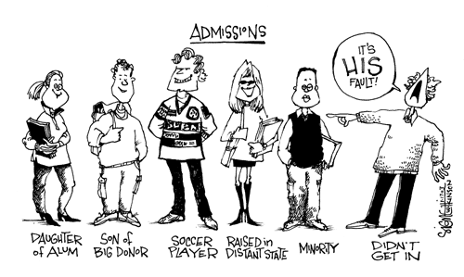
Policy Debate Question: Are affirmative action programs a reasonable distinction between classes of citizens?

Slide 22
Equal Protection Clause: Relevant Court Cases
Grutter v. Bollinger
The law school admissions process, which involved fewer students, entailed more individualized assessment of applicants but still gave significant advantage to blacks. One year, among applicants with GPAs between 3.25 and 3.49 and LSAT scores between 156 and 158, one of fifty-one whites was admitted, and ten of ten blacks were.
Toobin, 2008

Slide 23
Equal Protection Clause: Relevant Court Cases
The Gratz undergraduate case was deemed unconstitutional by a vote of 6-3 because it was too rigid and not individualized.
Grutter, however, was 5-4 in favor of Michigan’s law school admission because it appeared to the majority to be more like the Harvard policy Justice Powell cited in the Bakke decision and treated the applicants as individuals.
The Grutter case would become the more important of the two cases because the justices outlined when and how race would be permitted to be considered as a factor in university admissions. Justice O’Connor, writing for the majority, wrote about the need of a “critical mass” of minority students and that “diversity” as a “compelling state interest” would be left to universities to determine and not the courts because “universities occupy a special niche in our constitutional tradition”
Toobin, 2008, p. 261

Slide 24
Grutter Case Explained
Grutter v. Bollinger | Homework Help from the Bill of Rights Institute
https://www.youtube.com/watch?v=cEzSvagZ_60&feature=youtu.be

Slide 25
Equal Protection Clause: Relevant Court Cases
Schuette v. Coalition to Defend Affirmative Action Michigan
In the aftermath of the Grutter decision, Michigan voters pass a state constitutional amendment stating the state’s college and public university “shall not discriminate against, or grant preferential treatment to, any individual group on the basis of race, sex, color, ethnicity, or national origin”
Barnes, 2013, para. 7
Modeled after similar constitutional bans in states including California, Florida, Washington, Arizona, Nebraska, Oklahoma, New Hampshire and of course Michigan itself
Wolf, 2013

Slide 26
Equal Protection Clause: Relevant Court Cases
As a result of state constitutional bans, the percentage of African Americans among entering freshman at the nation’s top 29 universities in 2011 was lowest at the University of California-Berkley, UCLA, and the University of Michigan, despite efforts by those schools to use socioeconomic and other race-neutral criteria in search of diversity. From 2006 to 2012, the percentage of black undergraduates dropped from 7% to 4.7%, and Hispanics from 4.9% to 4.3%
Wolf, 2013

Slide 27
Equal Protection Clause: Relevant Court Cases
Coalition to Defend Affirmative Action alleges it violates the Civil Rights Act of 1991 disparate impact provision which allows a claim of discrimination to be established on the basis of disproportionate racial results.
disparate impact provision states that equal opportunity can only be measured by equal results. Whenever a policy does not produce equal results, there is a presumption of racial discrimination
Erler, 2012

Slide 28
Equal Protection Clause: Relevant Court Cases
Michigan alleges the ballot measure arguing that the state’s voters were not discriminating against minorities, but were rather trying to create an equal opportunity for all races to bid for the slots in admission
Denniston, 2013
“We need to achieve diversity by constitutional means, not by any means necessary,” Michigan’s attorney general Schuette says. “In Michigan, we don’t discriminate against anything or anybody, except discrimination“
Wolf, 2013, para. 32

Slide 29
Michigan's ban on affirmative action upheld by Supreme Court By Bill Mears, CNN Supreme Court Producer Updated 10:22 AM ET, Wed April 23, 2014
http://www.cnn.com/2014/04/22/justice/scotus-michigan-affirmative-action/

Slide 30
How do we make the system “Fair” and provide “opportunity” to those disadvantaged and not just those that are privileged to achieve the “American Dream?
Choice #1: Prohibiting Discrimination, Enforcing the Laws.
Our public commitment is to uphold the principle of equality under the law, for people of ALL races. The government’s obligation is to make sure the rules of the game are the same for everyone. BUT equality of opportunity does not necessarily lead to equal results.

Slide 31
How do we make the system “Fair” and provide “opportunity” to those disadvantaged and not just those that are privileged to achieve the “American Dream?
Choice #2: Affirmative Action Strategy: Taking Race into Consideration
Equal opportunity is not enough. Government must take measures to ensure equal RESULTS, even if affirmative action benefits minority groups at the expense of others. Racial equality can be achieved ONLY by allowing preferences for groups that have suffered from discrimination.

Slide 32
How do we make the system “Fair” and provide “opportunity” to those disadvantaged and not just those that are privileged to achieve the “American Dream?
Choice #3: Ladder Out of Poverty: Helping the Poor, Closing the racial Gap.
Because the obstacles to equality today are chiefly economic, race-specific remedies are no longer the most promising. Poverty MUST be attacked at its roots with aggressive social welfare programs that will help ALL low income people, even if such programs are costly.

Slide 33
Equal Protection Clause: Follow Up Question
Justice Harlan advocated in his lone dissent in the 1896 Plessy v. Ferguson decision, “Our Constitution is color blind, and neither knows nor tolerates classes among citizens”
Erler, 2013, p. 7
Is Our Constitution Colorblind? How do we enable all citizens to achieve the “American Dream” and ensure that “all men are born equal” as Thomas Jefferson penned?
Which of the following choices best accomplishes this goal?
Choice #1: Prohibiting Discrimination, Enforcing the Laws.
Choice #2: Affirmative Action Strategy: Taking Race into Consideration
Choice #3: Ladder Out of Poverty: Helping the Poor, Closing the racial Gap.

Slide 34
Ricci v. DeStefano (2009)
Facts
Employers use many strategies to identify the most qualified people to hire for a job. Some read resumes, use interviews, or call references. Many employers use job-related tests to find the most qualified people for a position. These tests are legal so long as they are related to the job and the results are not used to discriminate on the basis of race, sex, age, disability, religion, or national origin. In fact, federal law says tests that are neutral on their face, but have a significant adverse impact on one of those groups, are not allowed unless the test is job-related and there is no alternative that would produce less discriminatory results.
In 2003, the New Haven, CT, Fire Department had openings for the positions of captain and lieutenant. They decided to promote candidates from within the department, and hired an outside company to design an exam to determine the most qualified candidates. The exam results showed that none of the African American test-takers and only two of the Hispanic test-takers scored well enough to be considered for the promotion. The city held hearings to determine whether or not they should certify the results of the test.
Several firefighters stated that the test was fair and the questions were nationally recognized. Others complained that some questions were not relevant to the skills necessary for the positions. A professional organization noted that previous exams used by the city had not disproportionately excluded minorities, so something must be wrong with this test. The company that designed the test said the content was neutral. An industrial psychologist reviewed the results and suggested several alternative methods for assessing candidates’ qualifications. Finally, the city’s attorneys argued against certifying the results, saying that making promotions based on the test could violate Title VII, the federal law prohibiting employment discrimination.
The city decided not to certify the results, and no promotions were made. One Hispanic candidate and seventeen white candidates (including Ricci) who had taken the exam filed a lawsuit against the city, alleging that the failure to use the test results violated their Title VII rights. The district court found for the city, as did the Second Circuit Court of Appeals. Ricci and the others appealed to the US Supreme Court.

Slide 35
Ricci v. DeStefano (2009) (continued)
Issue
Can an employer reject the results of an employment test because one racial group scored substantially higher than others? Does this rejection violate the rights of the individuals who scored higher?

Slide 36
Ricci v. DeStefano (2009) (continued)
Federal Law
Title VII
“It shall be an unlawful employment practice for an employer to fail or refuse to hire or to discharge any individual, or otherwise to discriminate against any individual with respect to his compensation, terms, conditions, or privileges of employment, because of such individual’s race, color, religion, sex, or national origin”
“…nor shall it be an unlawful employment practice for an employer to give and to act upon the results of any professionally developed ability test provided that such test, its administration or action upon the results is not designed, intended or used to discriminate because of race, color, religion, sex or national origin.”

Slide 37
Ricci v. DeStefano (2009) (continued)
Arguments for Ricci
The city engaged in intentional discrimination by not promoting the well-qualified candidates because of their race. They didn’t want the white firefighters to get the promotions.
The city’s real desire was not to comply with Title VII, but rather to prevent the promotion of high-scoring candidates, based on their race. The city could have taken steps to study the exam and validate its neutrality, but instead it just threw out the results.
Whether it was their intention or not, the fire department, in effect, took away something that belonged to the white applicants because of their status as white.
Mere statistical disparities do not by themselves violate Title VII. There is only a violation if the disparities are combined with the employer’s inability to prove that the test is valid and the lack of a less discriminatory alternative. The city did not try to validate the test or figure out whether there was a less discriminatory alternative.
The city has no history of racial discrimination that they were trying to remedy.
Race discrimination constitutes deliberately disparate treatment on the basis of race, and the motive for such differential treatment (whether it is trying to right historical wrongs or not) is immaterial. Any decision to hire or promote a job candidate in part on the basis of her race is wrong and illegal.
The State has an interest in ensuring that employment, specifically employment such as firefighting where one’s skill level is incredibly important, is based on merit.
A Supreme Court decision for the city will sanction employers’ abilities to discriminate against whites.

Slide 38
Ricci v. DeStefano (2009) (continued)
Arguments for DeStefano / City of New Haven
Title VII explicitly deems neutral policies that have a disparate impact automatically suspect and requires an examination and justification if they are to be maintained.
The city was not intentionally discriminating against the high scoring white firefighters. They were simply fulfilling their obligation to comply with Title VII’s rule that a facially neutral test can’t be discriminatory in practice.
The disparate test results could lead a reasonable person to conclude that the test was measuring something other than a candidate's future quality of performance. The fact that not one African-American scored well is indicative of a flaw in the test.
The remedy (throwing out all the tests) was race-neutral because all races were affected the same way.
The petitioners do not have a valid claim of employment discrimination because no one suffered a negative employment action (a significant change in employment status); instead, no one was promoted. They did not lose promotions to someone else.
The city doesn’t have to have past violations of Title VII, nor a current proven violation, to take voluntary steps to avoid breaking the law.
The history of race in this country requires that we do our best to ensure that African-Americans are no longer excluded from the most sought-after positions in public life.
Discrimination is now largely subtle with institutional and systematic bias. The city has an obligation to respond to indicators of discrimination, like the disparate test results, even when there is no obvious, overt discrimination.
To perform a public function effectively, any governmental department must be well-integrated and must accordingly avoid having a de facto color line in its ranks.

Slide 39
Ricci v. DeStefano (2009) (continued)
Issue
Can an employer reject the results of an employment test because one racial group scored substantially higher than others? Does this rejection violate the rights of the individuals who scored higher?

Slide 40
Ricci v. DeStefano (2009) (continued)
Decision
Justice Kennedy wrote the opinion of the Court, in which Chief Justice Roberts and Justices Scalia, Thomas, and Alito joined. Justice Scalia wrote a concurring opinion. Justice Alito wrote a concurring opinion, in which Justices Scalia and Thomas joined. Justice Ginsburg wrote a dissenting opinion, in which Justices Stevens, Souter, and Breyer joined.

Slide 41
Ricci v. DeStefano (2009) (continued)
Majority
In a 5-4 decision, the Court ruled that New Haven violated Title VII when it threw out the test results. Title VII prohibits two types of discrimination: disparate treatment (intentional discrimination) and disparate impact (actions that don’t appear discriminatory on their face, but are in their effects). The Court held that the city’s decision to throw out the test results constituted disparate treatment of those firefighters eligible for promotion because the results were thrown out based solely on race. They held that an employer cannot engage in disparate treatment simply because they fear a disparate impact lawsuit (as the city justified its decision to throw out the test results by claiming that if it had not, it would have faced a disparate impact claim from the African American firefighters).
The Court asserted that an employer could engage in intentional discrimination only if it could show that there was a strong basis in evidence that it would be held liable in a disparate impact suit from other employees. In other words, New Haven could only throw out the test results (an intentionally discriminatory act) if it could show a strong basis in evidence that it would lose a disparate impact claim by the African American firefighters. The Court found that New Haven did not show this strong basis in evidence because, while the test results did have a discriminatory effect, New Haven could have defeated the disparate impact claim by proving that the test was job related and that there was not a less-discriminatory alternative available.

Slide 42
Ricci v. DeStefano (2009) (continued)
Dissent
The dissent argued that New Haven’s decision to throw out the test results did not violate Title VII, disputing the Majority’s ruling on several grounds. First, the dissent asserted that employers who reject a test because of a disparate impact are not engaging in intentional discrimination. Second, they asserted that the “strong basis in evidence” standard is arbitrary and should not apply. Instead, they would argue that employers need only to have good cause to believe that the job test could not be proven to be a business necessity with no less discriminatory alternatives. The dissenting justices pointed out that there was ample evidence to question how well the test actually measured relevant job-related information. There was also evidence that there may have been less-discriminatory alternative methods for determining promotions required that the test results. Therefore, New Haven had good cause to believe that the test would not meet Title VII’s requirements for job-relatedness and less discriminatory alternatives and should have thrown the test out.
The dissent pointed out that there has been a long history of racial discrimination, particularly in firehouses, and Title VII has been an effective tool in combating practices that may appear facially neutral, but are, in effect, discriminatory. The city was reasonably trying to avoid a disparate impact claim from the minority firefighters. The majority’s decision will discourage employers from taking voluntary actions to prevent disparate impact out of fear that they will face disparate treatment claims from others. Finally, the dissent criticized the Court’s decision to rule that New Haven had violated the new “strong basis in evidence” standard, rather than giving the city a chance to prove they did have a strong basis in evidence in the lower courts.

Slide 43
Works Cited
Bill of Rights. (n.d.). Teaching American history website. Retrieved from http://teachingamericanhistory.org/library/document/bill-of-rights/
Barnes, R. (2013. October 13). Michigan is back with affirmative action fight. Washington Post Retrieved from http://www.washingtonpost.com/politics/michigan-is-back-with-affirmative- action-fight/2013/10/13/9d7e216c-32a8-11e3-9c68-1cf643210300_story.html
Biskupic,J. (2009). American Original: The life and constitution of Supreme Court Justice Antonin Scalia. New York: Sarah Crichton Books
Dalmia, S. (2013, October 13). Leave affirmative action up to the states USA Today Retrieved from http://www.usatoday.com/story/opinion/2013/10/13/affirmative-action-michigan-prop-2- column/2977063/
Declaration of Independence. (n.d.). Teaching American history website. Retrieved from http://teachingamericanhistory.org/library/document/declaration-of-independence/
Denniston, L. (2013, October 12) “Argument preview: Race’s role on campus, society” scotusblog.com website. Retrieved from http://www.scotusblog.com/2013/10/argument- review-races-role-on-campus-in-society/

Slide 44
Works Cited Continued
Denniston, L. (2013, October 16) “ Constitution Check: Does banning affirmative action promote racial equality? “ constitutioncenter.org website. retrieved from: http://blog.constitutioncenter.org/2013/10/constitution-check-does -banning-affirmative-action-promote-racial-equality/
Emanuel, S. (Ed.). (2012). Emanuel law outline (Vol.13) New York; Wolters Kluwer Law and Business
Erler, E. (2012, November). Is the Constitution colorblind. Hillsdale Imprimus (Vo.l 41 No. 11)
Remy, R. (Ed). (2003). United States government: Democracy in action (Vol. 5). Columbus, OH; Glencoe/McGraw-Hill
Ross, B. (2013, November 18) “The Death of a President?” New York Times Upfront, 146, p . 16-19
Toobin, J. (2007). The Nine. New York: Anchor Books
Wilson, J., Diluilio, J., and Bose, M. (Ed.) (2013). American Government: Institution and policies (Vol.13) Boston; Wadsworth, Cengage Learning
Wolf, R. (2013, October 13). Court to decide if race preferences bans hurt diversity. USA Today Retrieved from http://www.usatoday.com/story/news/nation/2013/10/13/supreme-court-affirmative- actionmichigan/2962067/

